Slide 1



Presentation of the idea
Presentation of the idea
Team number* Exp: Team 1

Slide 2
*Note: this slide is for informational purposes, delete it before pitching.
1
Who are you?
Introduce your team, who are part of it? what makes you special? what is your name? what is your motto?
What is the problem?
2
Present the challenge and problem that we have identified, and why it is important to solve it.
Data: shocking fact
3
We want them to see the importance of solving this problem, so we have to deliver hard-hitting data to get attention from the get-go.
4
How do we solve the chanllenge/problem?
Explain how we solve the challenge, who we impact and with what technology. What is our proposal and what benefits does it offer?
5
Impact
Explain the impact of the prototype within the company in terms of time and cost savings, benefits and scope of the prototype.
New proposal
6
Show the prototype that we have made, clearly explaining the solution, the flows and the wireframes. Storyboard support to explain the solution.
7
Next steps
Demonstrate that there is a motivation to develop it and explain what our next steps will be to start it up.

Slide 3


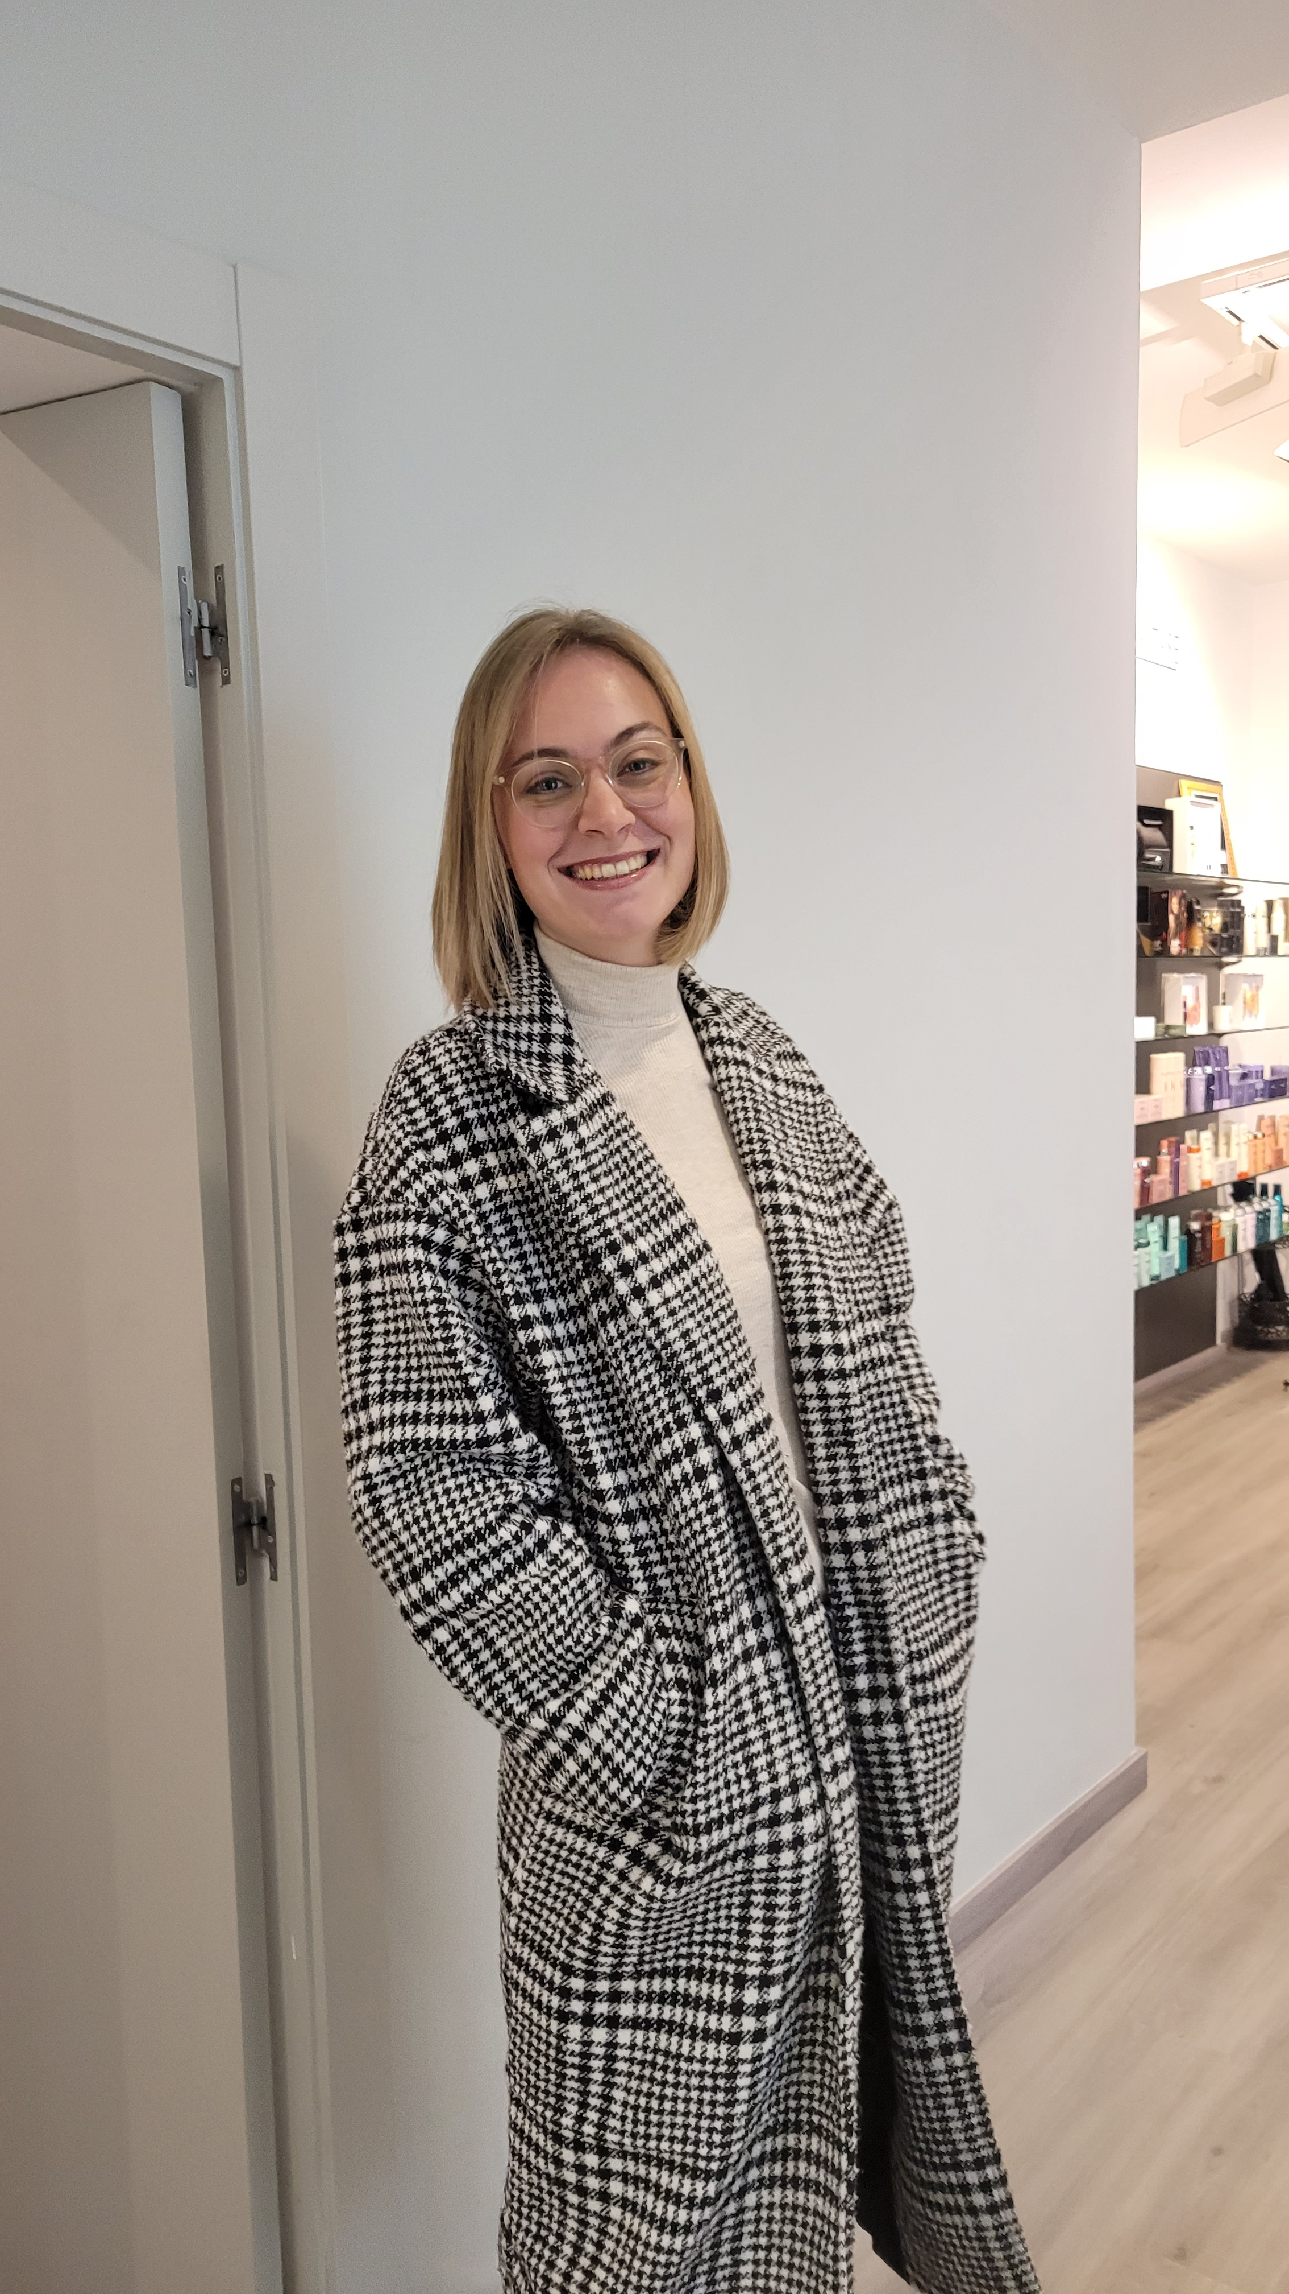


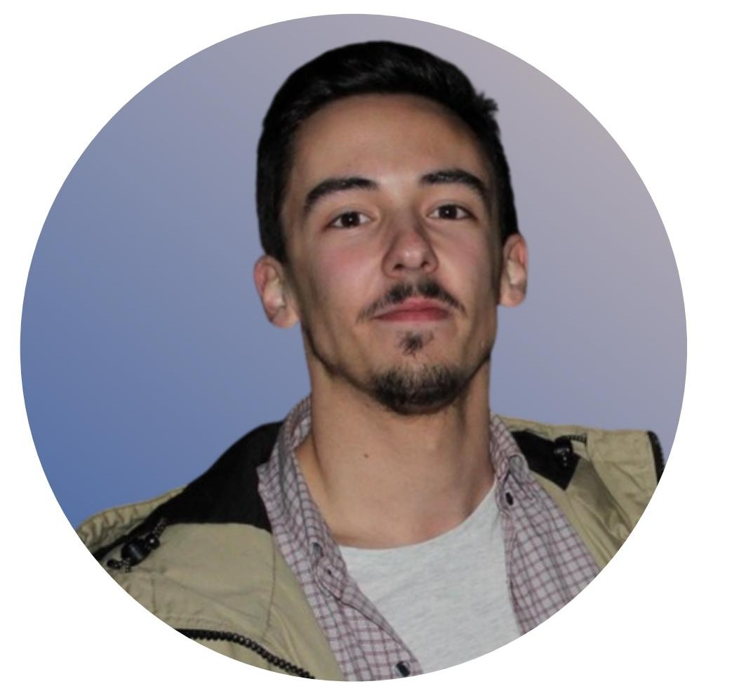

About us
No ingredient, imperfect food and peel will ever be safe again!
Arnaud
IoT
Research Engineer
Laura
Marketing Professional
Julianne
Data
Analyst
Yassine
IoT
Research Engineer
Bruno
Consultant
Sandra
Startup CEO /Sustainability Expert

Slide 4
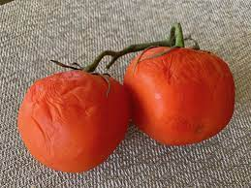
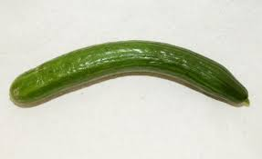

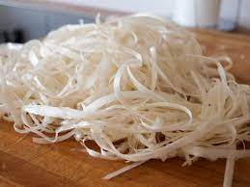
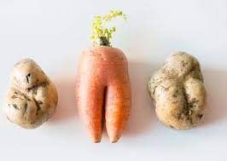
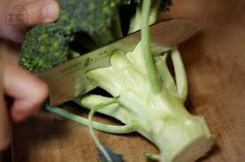
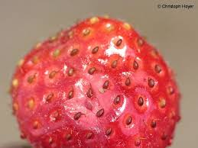

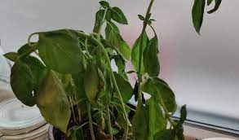


Slide 5
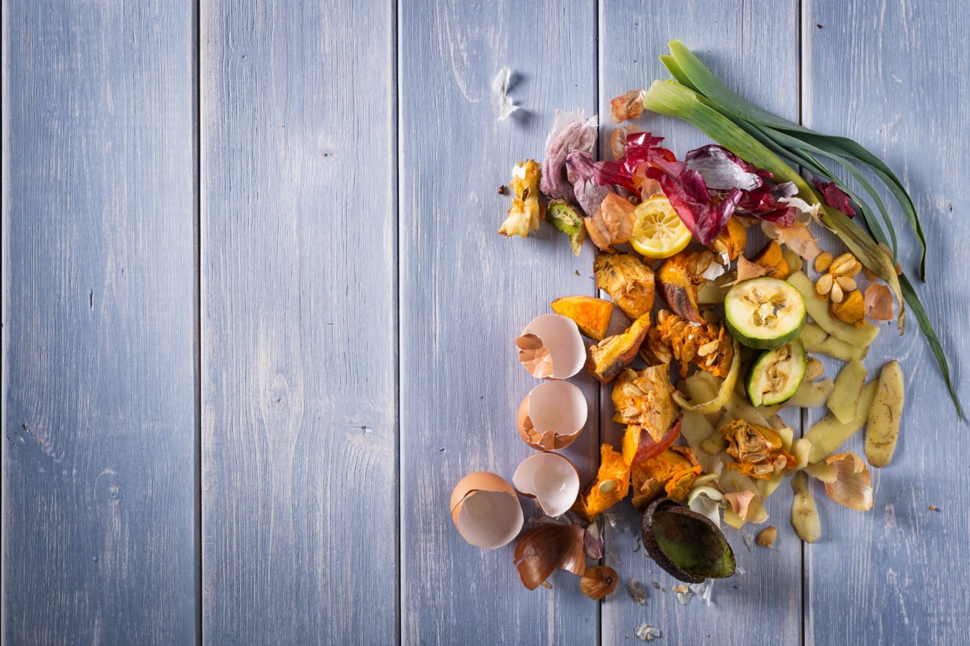
What is the problem?
Food waste caused during the step of reception and further processing of ingredients due to an inefficient usage
Notes:
A significant amount of waste can be avoided by optimizing/upcycling the use of raw ingredients (including subproducts/sub-parts).
There is also potential to use raw ingredients which are not received from the suppliers in optimal shape/condition

Slide 6






Data: shocking fact
~40% of food waste is generated
from farm to restaurant
eg. by imperfect products not being accepted by buyers
In the restaurant itself,
Over 65% of waste occurs during prepping, causing an estimated cost of 13 billion €1
1: Source: EUROSTAT FAQ 2023: https://food.ec.europa.eu/system/files/2023-04/fw_lib_reduce-food-waste-eu_faqs_0.pdf

Slide 7

How do we solve the challenge/problem?
AI optimized stock monitoring and menu planning, to help SME restaurants keep track of their stock and optimize ingredient usage

Slide 8
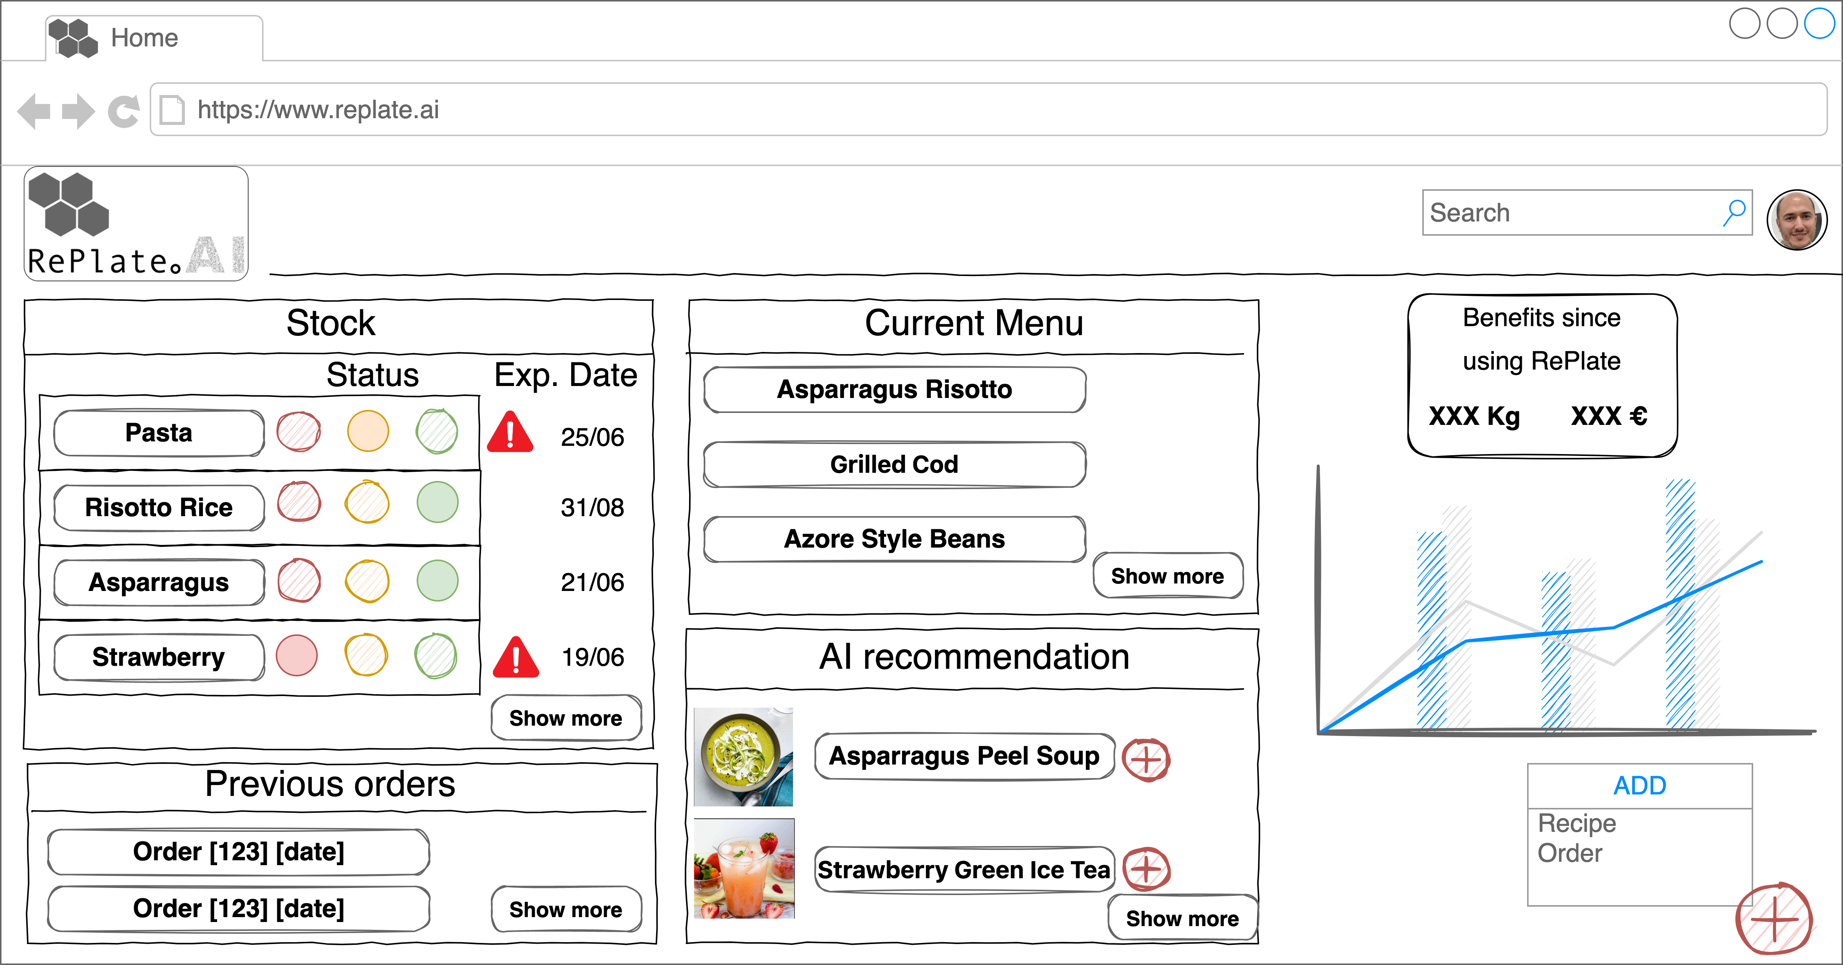



Our proposal
by

Slide 9
Our proposal
by

Slide 10
Our proposal
by

Slide 11
Our proposal
by

Slide 12






Impact
Increase overall profitability of the menu to up to 10%
Cut costs by 2-6%, also on garbage (country dependent)
Monitor stock (freshness/expiry dates)
Track supplier quality
Save time with automated ordering suggestions
Optimal use of all parts of raw ingredients and imperfect food that would otherwise be wasted

Slide 13


Next steps
Pilot launch of beta MVP
User testing
2
1
3
Feasibility of functionalities
Beta MVP development
User research with restaurants to test hypothesis and identify pains in the field

Slide 14
Why us?
Innovative and feasible idea that simplifies and automates existing processes conducted by SMEs (eg. Stock monitoring, order placement, menu planning)
Constant monitoring and optimal usage of ingredients increases profitability for the SMEs and thus helps to build a more robust and resilient sector
Multidisciplinary team with experience in innovation and sustainability in the agri-food and restaurant sector (IT, data analysis, consultancy, nutrition, business)
Experience in EU Projects as well as large network of restaurant agri-food SMEs and food waste specialists for user testing, con and feedback
High motivation and passion to fight food waste in the restaurant sector

Slide 15





FIGHT THE WASTE – INCREASE THE TASTE
Thank you!

Slide 16
Impact
*Note: how many businesses does your idea affect / how are you going to measure the positive result (impact) of your idea
Brief explanation of the main benefit and impact (numbers) of solving the problem with the proposed idea
Brief explanation of the main benefit and impact (numbers) of solving the problem with the proposed idea
Brief explanation of the main benefit and impact (numbers) of solving the problem with the proposed idea

Slide 17
Next steps
Brief explanation of the main steps we need to follow for the implementation
2
1
3
Brief explanation of the main steps we need to follow for the implementation
Brief explanation of the main steps we need to follow for the implementation

